Slide 1
Creating a pop-up museum
Course project
UPDH

Slide 2
What is a pop-up museum
Set up for a very period of limited time
At a location where no regular museum has operated before
Should target an audience that are not traditional museum or gallery enthusiasts
Should start meaningful conversations and reflections

Slide 3
Phase 1: Planning
In this phase you shall be brain-storming about the theme of your pop-up museum and the form you would like to take. In doing this the following things need to be kept on mind:
Audience
Exhibition story or theme
Objects, stories, inspiration

Slide 4
Important deadlines to note for this phase
Formation of the final groups: August 20
Submission of a brief concept note: September 1
Meetings with the course instrictor (of needed) to discuss the theme: Between Sep 2-10
Approval of the theme: by September 15

Slide 5
Phase 2: Develop Sub-themes
Exhibition sections
Research exhibition sub-themes
Source objects
Think of ideas for making your musueum ineractive
Create an annotated list of planned exhibits and anyolanned interactive elements
Submission: October 1

Slide 6
Phase 3: Designing your exhibition
Exhibition design
Grouping and arrangement of exhibits
Exhibit display
Logistics and budget
Submit a floorplan and buget of your meuseum keeping in mind all the points abobe: by October 15

Slide 7
Phase 4: Develop Text and promotional material
Introduction: You need to write one introductory text panel about the whole exhibition to explain what it is about. This should be approximately 200 words
Section panels: You need to write an introductory text panel for each section of the exhibition to explain the theme of the section. These panels should be about 200 words each.
Object/exhibit labels: Labels are a useful way to share information about what is on display. On the labels include the title/name of the object or specimen, the date it was made or collected (if known and relevant), a description, and the object or specimen's story. Keep the audience in mind with an aim to develop text that will interest them, keep it brief, use short sentences, and try to stick to a limited word count so the labels look consistent.
Promotional material: Create posters and flyers using persuasive language which entices your audience to want to come along. Think about what would make your audience want to come along and why.
A visitors’ book: For collecting the feedback of those visiting your pop-up museum
October 16-November 6

Slide 8
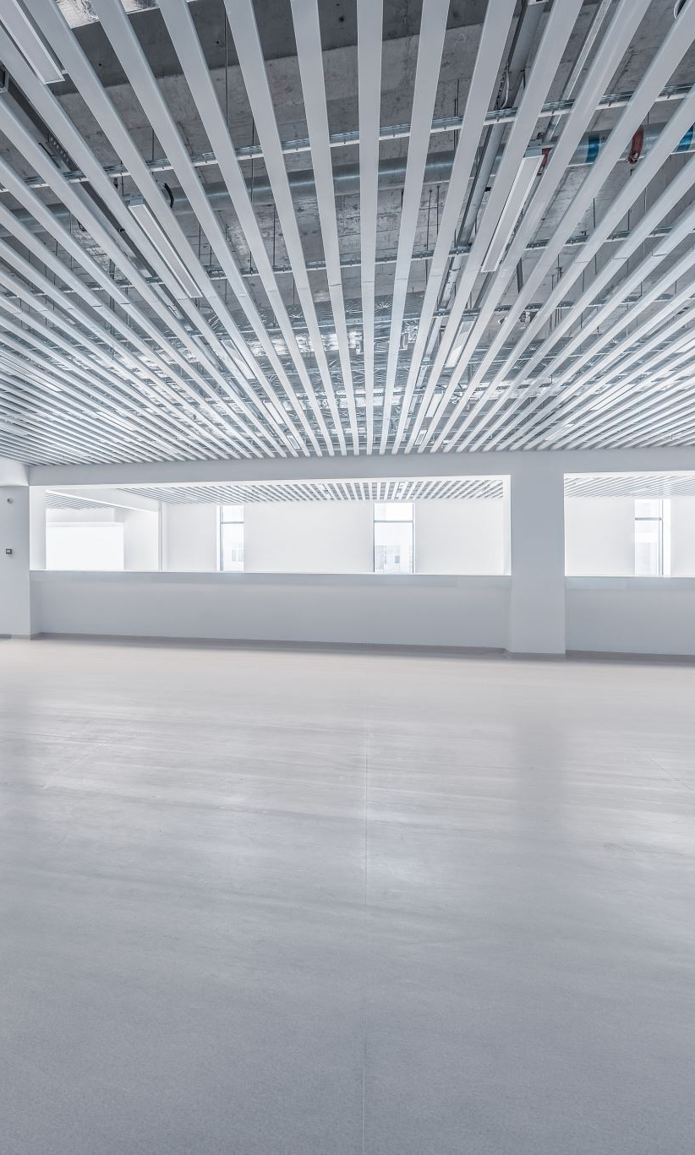
Phase 5: Construct the pop-up museum
Physically arrange your exhibition
Plan how you shall guide visitors through it on the day
Dates: TBA

Slide 9
Final report
After the pop-up exhibition is over, each group shall submit a repot giving an account of how they went about the whole process, what was the contribition of each group member, what challenges they faced and how they sought to figure them out and finally reflections on the main learnings from the project
Deadline : TBA

